Slide 1

郑凯文
2018 - 11 - 15
TimeReach: Historical Reachability Queries on Evolving
Graphs
2015 EDBT( Extending Database Technology)
Notes:
EDBT / ICDT研讨会主席
Nikolaus Augsten，奥地利萨尔茨堡大学
第28届地理标志 - 数据库基础研讨会

Slide 2


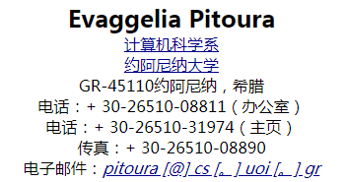


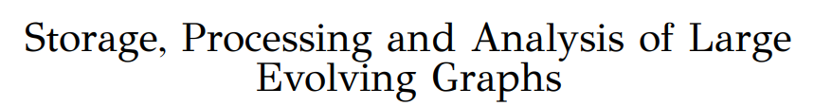

Slide 3
Outline
1
Introduction
2
Existing Approach
3
Our Approach
4
Experimental
5
Conclusion

Slide 4
Introduction
1

Slide 5
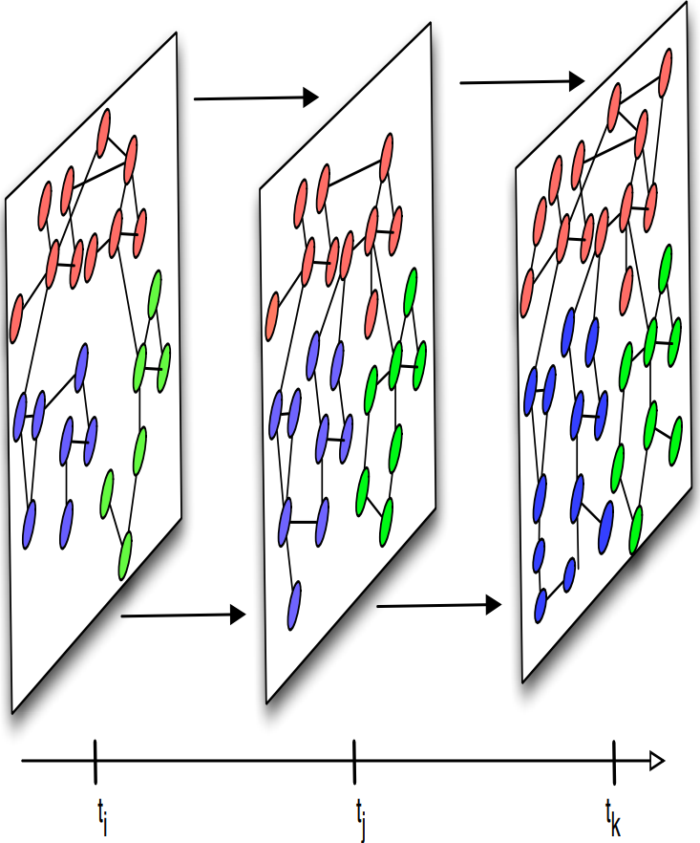
Introduction
Evolving Graphs

Slide 6
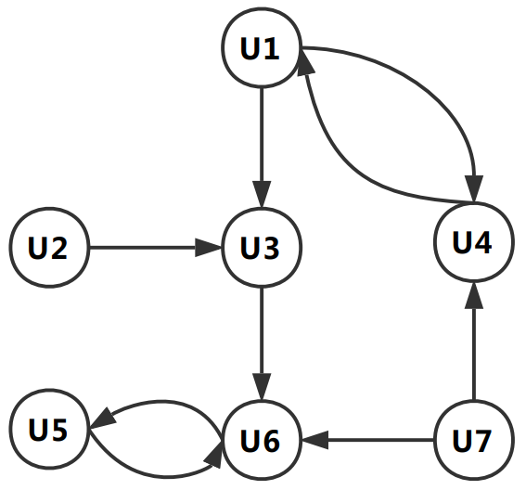
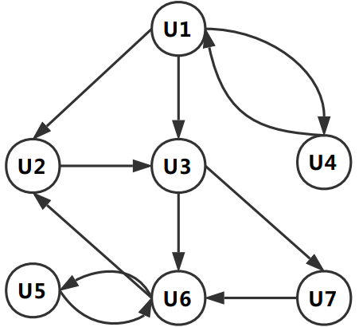
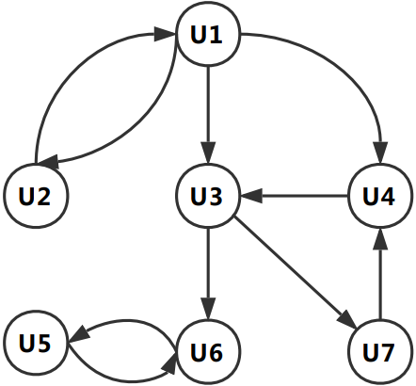
Introduction
Defintion
G_{t0}
G_{t1}
G_{t2}
G_{tn}
.....
time

Slide 7
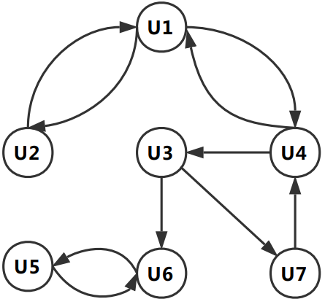
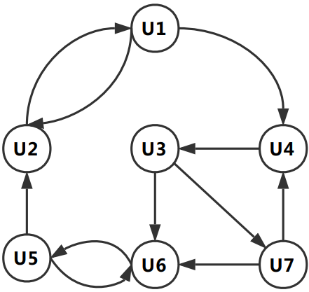
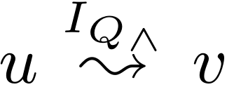
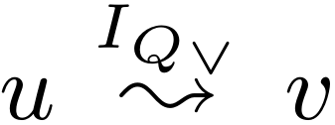
Introduction
Defintion
G_{t0}
G_{t1}
G_{t2}
G_{t3}
Snapshot: G_{t}=( V_{t} ，E_{t} )
Evolving Graphs:
Q( U₃ ,U₁ ,[0,3] )
Query
Q( U₁ ,U₇ ,[0,3] )

Slide 8
Existing Approach
2

Slide 9
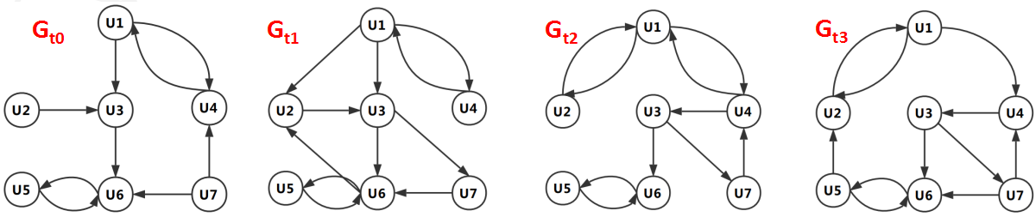
Existing Approach
1. Partial Order
Index All Snapshot (IAS)
Transitive Closure Compression
SCISSOR

Slide 10

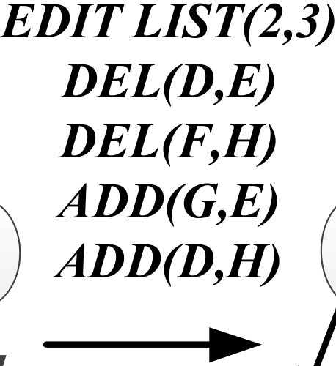
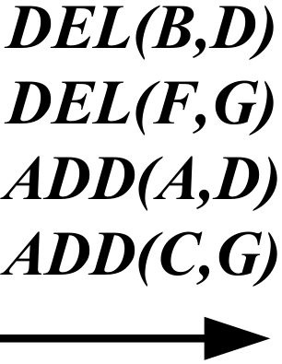
Existing Approach
SCISSOR
0
A
15
A
A
B
F
1. Partial Order
1
8
9
14
B
F
D
B
F
D
2
C
3
4
D
7
G
H
C
H
E
C
H
10
11
12
13
E
G
G
5
6
SNAPSHOT - 1
SNAPSHOT - 2
E
SNAPSHOT - 3
Time-Evolving Hierarchies
Time-Evolving Graph

Slide 11
Our Algorithm
3

Slide 12
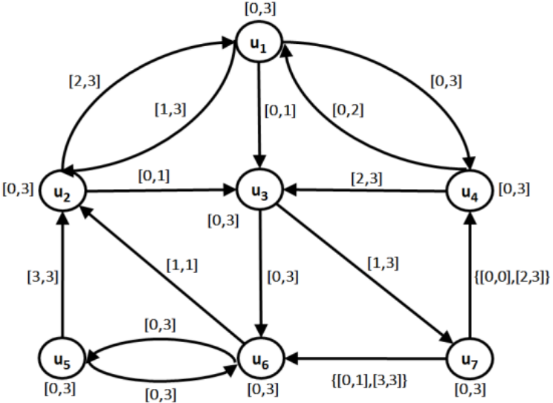
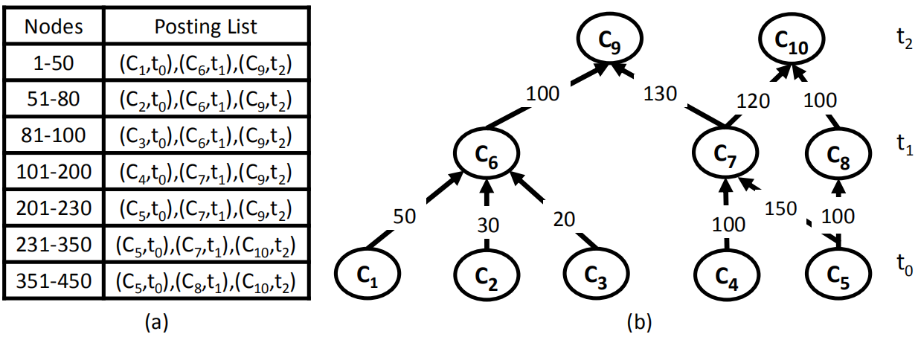
Our Approach
Version Graph
TIMEREACH

Slide 13
Our Approach
Version Graph
Lable of Path: L(p)
example:p={(u4,u3) ,(u3,u7) ,(u7,u6)}
L(p) = {[2.3]} ⊗{[1,3]} ⊗{[0,1],[3,3]} = {[3,3]}
Lable of (u,v): L(u,v)
example: P(u4,u6)={p1,p2,p3,p4,p5,p6}
p1 = u4u3u6, p2 = u4u3u7u6,
p3 = u4u1u3u6, p4 =u4u1u3u7u6,
p5 = u4u1u2u3u6, p6 = u4u1u2u3u7u6
L(u4, u6) = {[2, 3]}⊕ {[3, 3]} ⊕ {[0, 1]} ⊕ {[1, 1]}
⊕ {[1, 1]} ⊕ {[1, 1]} = {[0, 3]}

Slide 14


Our Approach
Version Graph
Query
L(u4, u6) = {[0, 3]}
Q( u4 , u6 , [1,3])

Slide 15
Our Approach
Version Graph
I = {[2, 4], [9, 10], [13, curr]} and T = 16
I → B_{I} =(00111000011001111)
I ⊗I' is computed as B_{I} logical-AND B_{I}'
I ⊕ I' is computed as B_{I} logical-OR B_{I}'

Slide 16

Our Approach
Version Graph
Historical Transitive Closure
we maintain a single transitive closure,
C_{LI} for the version graph V_{GI}
=
Query

Slide 17


Our Approach
Version Graph
Online Traversal of the Version Graph
BFS Traversing only edges e such that
for each
Q( u2 , u4 , [0,1])

Slide 18
Our Approach
TIMEREACH

Slide 19
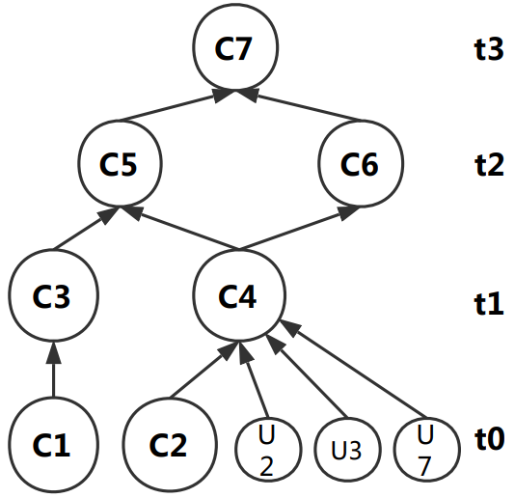
Our Approach
TIMEREACH
c₁
c₅
c₇
c₃
c₄
c₆
c₂
Nodes | posting list
U1 | (C1,t0) , (C3,t1) , (C5,t2) , (C7,t3)
U2 | (C4,t1) , (C5,t2) , (C7,t3)
U3 | (C4,t1) , (C5,t2) , (C7,t3)
U4 | (C1,t0) , (C3,t1) , (C5,t2) , (C7,t3)
U5 | (C2,t0) , (C4,t1) , (C6,t2) , (C7,t3)
U6 | (C2,t0) , (C4,t1) , (C6,t2) , (C7,t3)
U7 | (C4,t1) , (C5,t2) , (C7,t3)

Slide 20
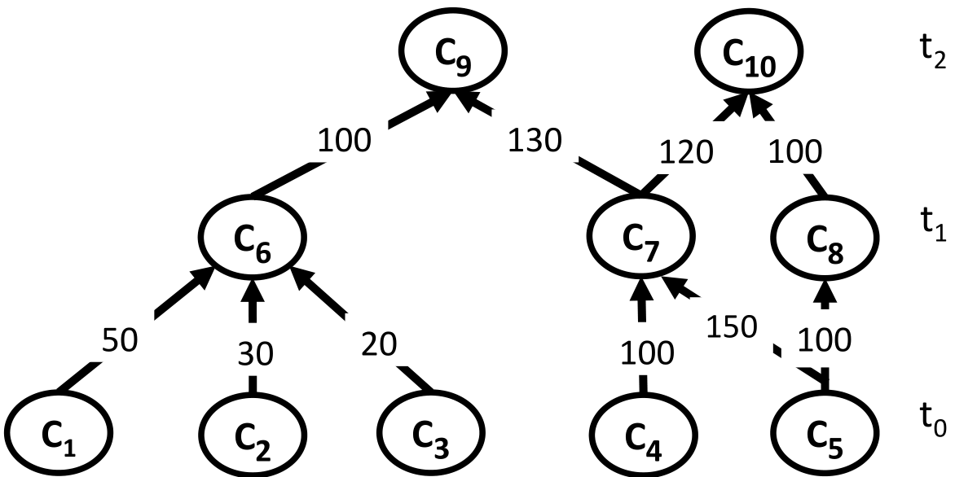
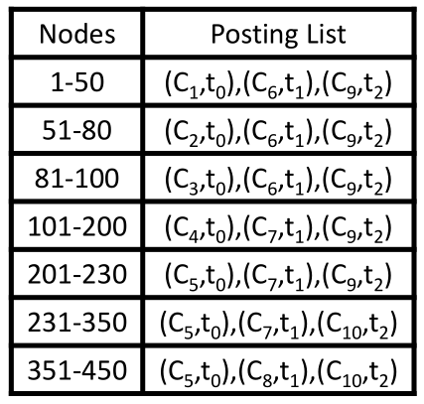
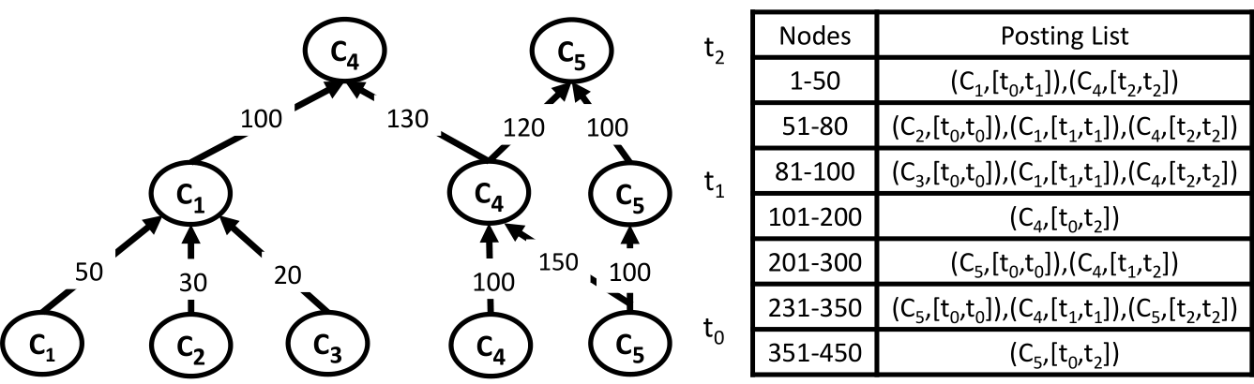
Our Approach
Condensed TIMEREACH
maximum weight bipartite matching

Slide 21
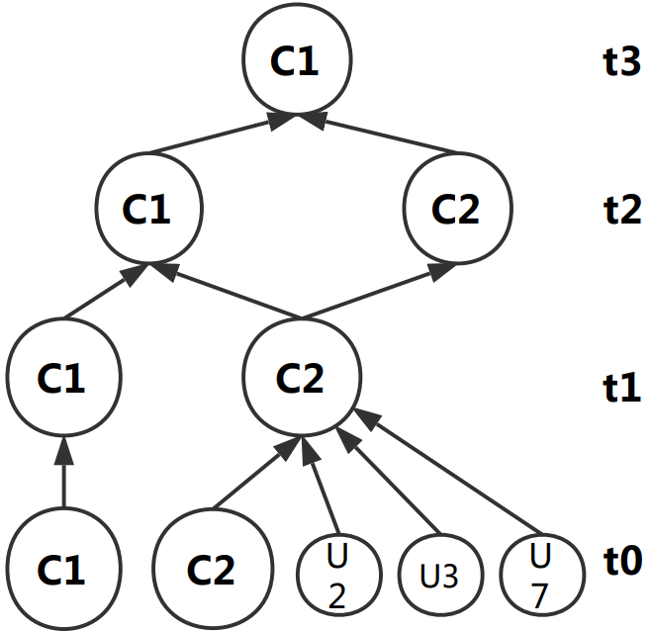
Our Approach
Condensed TIMEREACH
Nodes | posting list
U1 | (C1,t0) , (C3,t1) , (C5,t2) , (C7,t3)
U2 | (C4,t1) , (C5,t2) , (C7,t3)
U3 | (C4,t1) , (C5,t2) , (C7,t3)
U4 | (C1,t0) , (C3,t1) , (C5,t2) , (C7,t3)
U5 | (C2,t0) , (C4,t1) , (C6,t2) , (C7,t3)
U6 | (C2,t0) , (C4,t1) , (C6,t2) , (C7,t3)
U7 | (C4,t1) , (C5,t2) , (C7,t3)
Nodes | posting list
U1 | (C1,[t0,t3])
U2 | (C2,[t1,t1]) , (C1,[t2,t3])
U3 | (C2,[t1,t1]) , (C1,[t2,t3])
U4 | (C1,[t0,t3])
U5 | (C2,[t0,t0]) , (C2,[t1,t2]) , (C1,[t3,t3])
U6 | (C2,[t0,t2]) , (C1,[t3,t3])
U7 | (C2,[t1,t1]) , (C1,[t2,t3])

Slide 22
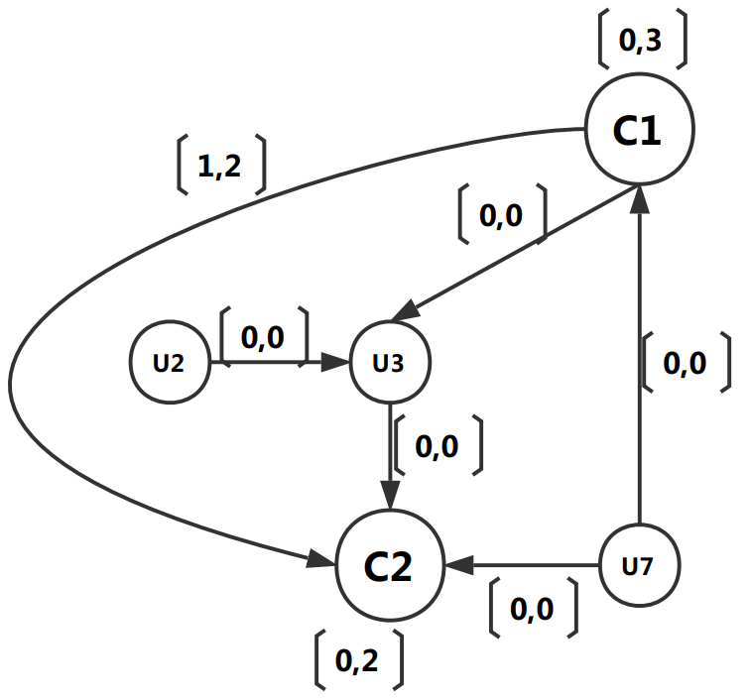
Our Approach
Condensed Version Graph
c₁
c₅
c₇
c₃
c₄
c₆
c₂

Slide 23
Our Approach
Condensed Version Graph

Slide 24
Our Approach
Query Processing
Version Graph
Condensed TIMEREACH
Nodes | posting list
U1 | (C1,[t0,t3])
U2 | (C2,[t1,t1]) , (C1,[t2,t3])
U3 | (C2,[t1,t1]) , (C1,[t2,t3])
U4 | (C1,[t0,t3])
U5 | (C2,[t0,t0]) , (C2,[t1,t2]) , (C1,[t3,t3])
U6 | (C2,[t0,t2]) , (C1,[t3,t3])
U7 | (C2,[t1,t1]) , (C1,[t2,t3])

Slide 25
Our Approach
Query Processing
Example:
Q( U7 , U5 , [0,3])
Example:
Q( U1 , U4 , [0,3])
Version Graph
Condensed TIMEREACH
Nodes | posting list
U1 | (C1,[t0,t3])
U2 | (C2,[t1,t1]) , (C1,[t2,t3])
U3 | (C2,[t1,t1]) , (C1,[t2,t3])
U4 | (C1,[t0,t3])
U5 | (C2,[t0,t0]) , (C2,[t1,t2]) , (C1,[t3,t3])
U6 | (C2,[t0,t2]) , (C1,[t3,t3])
U7 | (C2,[t1,t1]) , (C1,[t2,t3])

Slide 26
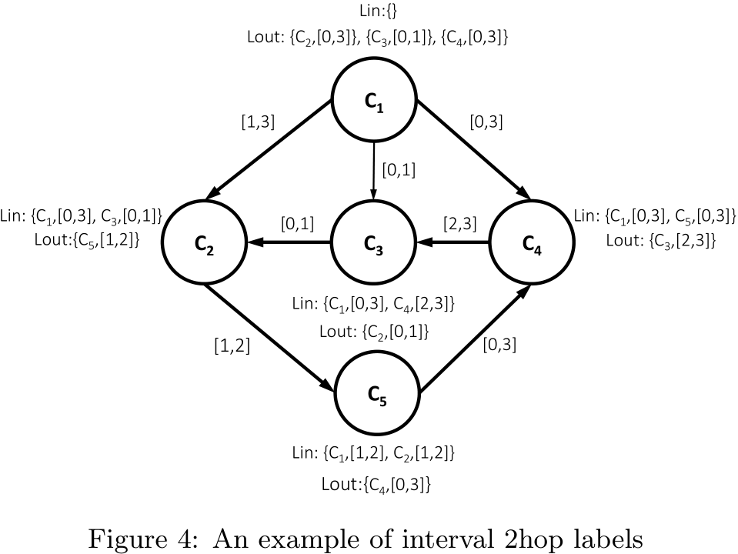
Our Approach
Interval 2Hop
根据 连通分量的
Version Graph
图的信息构造

Slide 27
Experimental
4

Slide 28
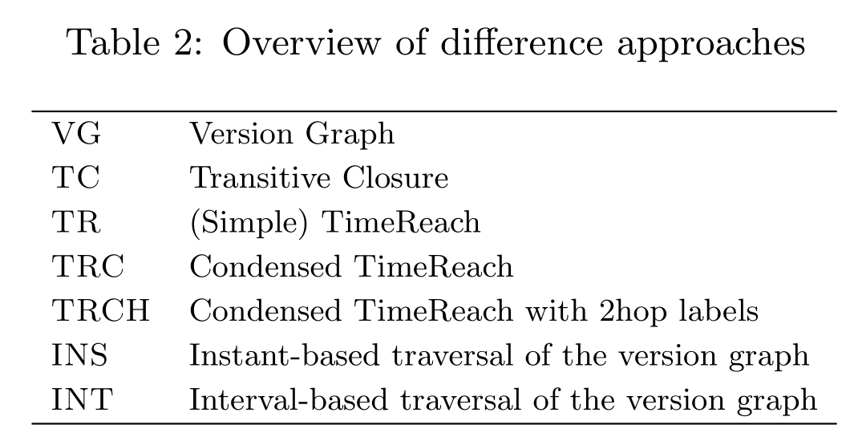
Experimental

Slide 29
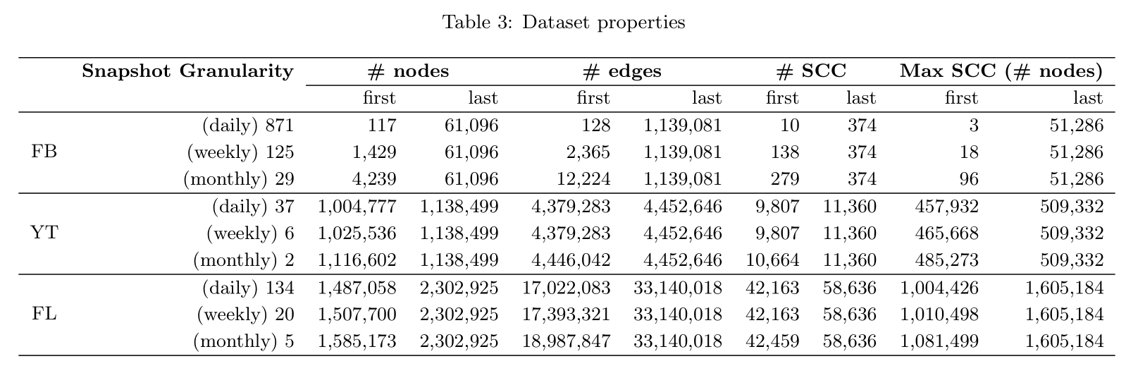
Experimental

Slide 30
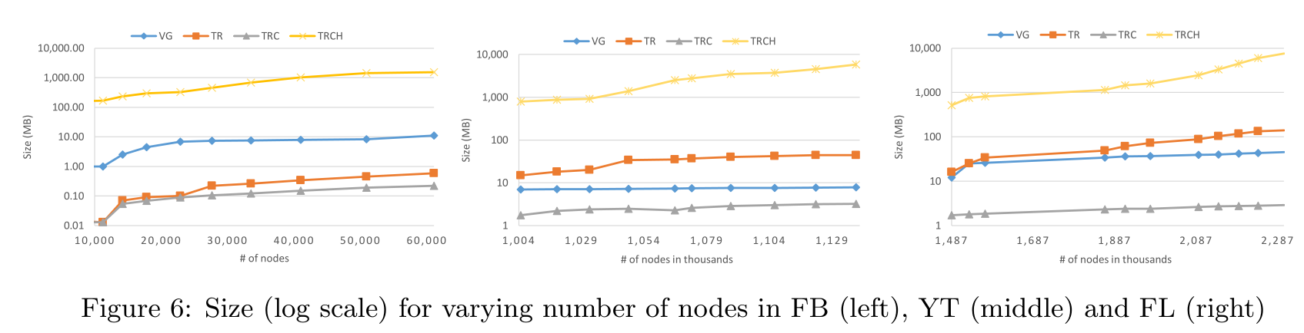
Experimental

Slide 31
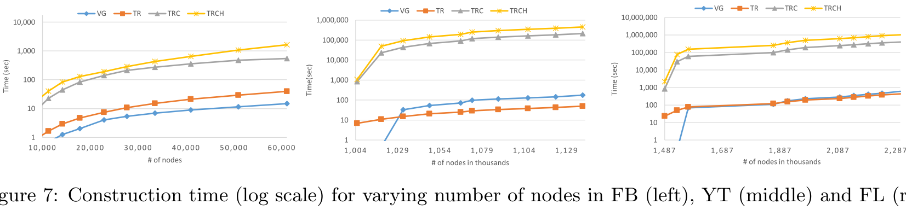
Experimental

Slide 32
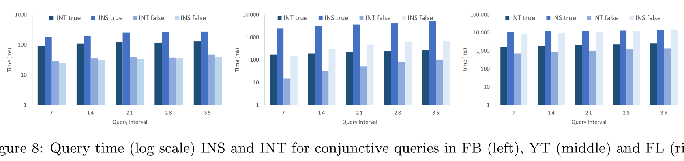
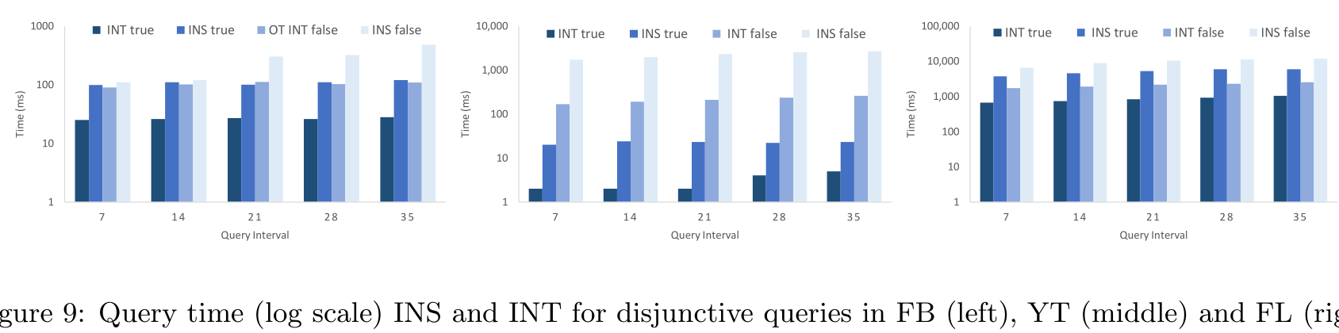
Experimental
Random Run 500 queries

Slide 33
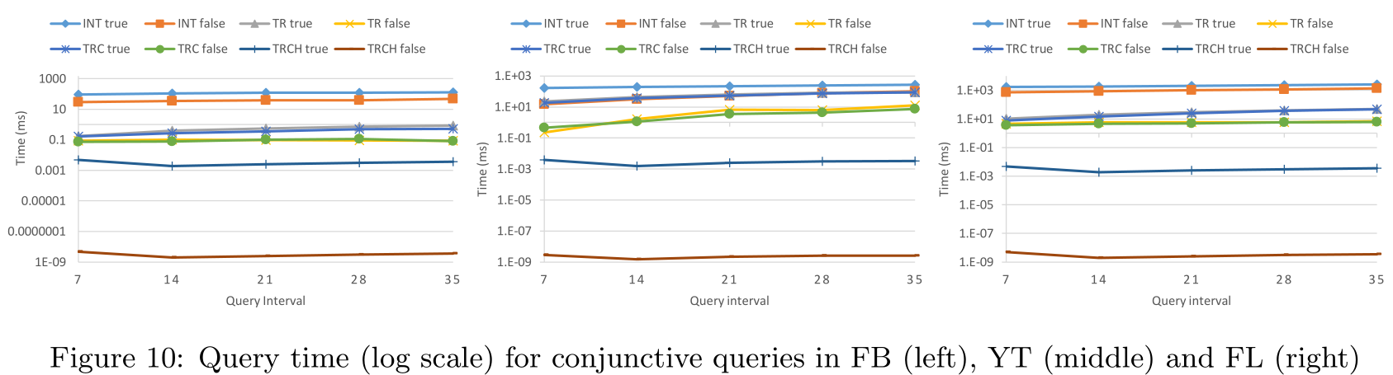
Experimental
Random Run 500 queries

Slide 34
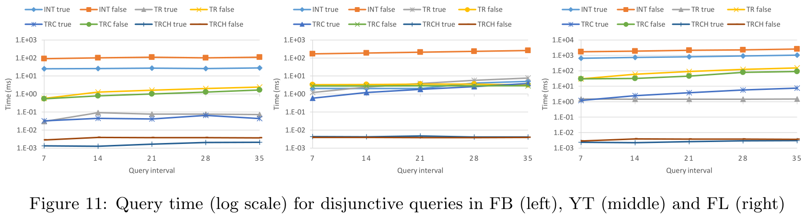
Experimental
Random Run 500 queries

Slide 35
Conclusion
5

Slide 36
Conclusion
Traversal
Version Graph
Transitive Closure
Condensed Version Graph
Evolving Graphs
SCC → posting list
Condensed TIMEREACH
(maximum weight bipartite matching)
TIMEREACH
Interval 2Hop

Slide 37

Thank for your time!

